Slide 1
A career choice with Ms Dallison

Slide 2
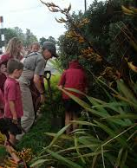

Slide 3
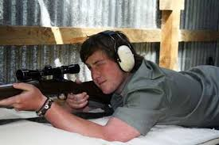

Slide 5
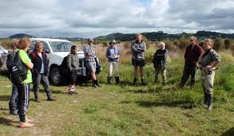
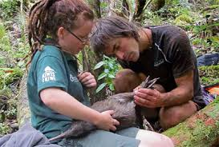

Slide 6
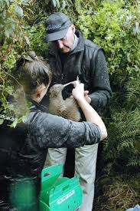
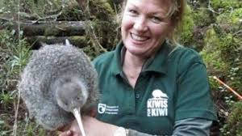

Slide 7
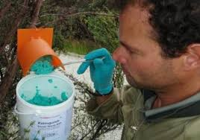
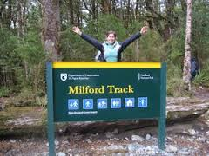

Slide 8
Āpiha Papa atawhai

Slide 9
Āpiha Papa atawhai
Ranger

Slide 10
Āpiha Papa atawhai
What does a Ranger do?
Rangers supervise, maintain, enhance and protect conservation areas such as forests, coasts, wetlands, national parks, maritime parks, regional parks, reserves, and sites of historical or cultural importance.
Personal Requirements?
Rangers need to be;
adaptable and practical
safety concious
able to remain calm in emergencies
motivated, as they may have to work in difficult conditions such as outdoors in weather
able to work independently or as part of a team
friendly, patient and helpful, as they deal with the public
knowledgeable about first aid.
Ranger

Slide 11
Āpiha Papa atawhai
Entry requirements?
There are no specific entry requirements to become a ranger. However, a National Certificate in Conservation (Trainee Ranger) is useful. This is a one-year course run by Nelson Marlborough Institute of Technology.
A Bachelor of Science, or completing a conservation or management course is also helpful.
Secondary Education?
Useful subjects include Māori, English, biology, agriculture and horticultural science, and geography.
Ranger

Slide 12
Āpiha Papa atawhai
Useful experience?
volunteer conservation work
taking online courses run by the Department of Conservation
outdoor experience such as tramping, camping or farming
doing a First Aid Certificate or Risk Management Certificate course
building experience
experience with native birds and insects.
A knowledge and understanding of Māori culture and protocol is also useful.
Ranger

Slide 13
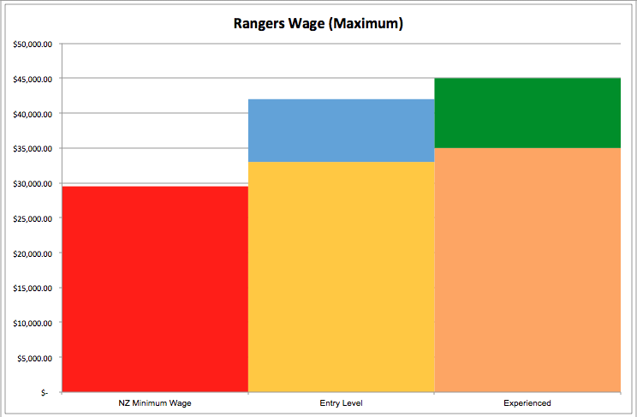
Āpiha Papa atawhai
Pay:
Entry level rangers usually earn between
$33K - $42K per year
This is approximately
$533 - $673per week
Experienced rangers usually earn between
$35K - $47K per year
This is approximately
$564 - $751
$47,000
$42,000
$33,000
$35,000
$29,500
Ranger

Slide 14
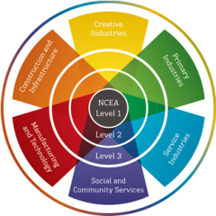
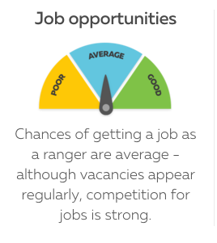

Slide 15
